Slide 1
URBACT III – Main orientations Brief Facilitators Info Days 2014 Paris, 03 October 2014

Slide 2
URBACT III Main provisions & Calendar NB: OP NOT APPROVED BY EC YET !!!

Slide 3
4 Specific Objectives
1 - To improve the capacity of cities to manage sustainable urban policies & practices in an integrated and participatory way
2 - To improve the design of sustainable urban strategies & action plans in cities
3 - To improve the implementation of Integrated Plans for sustainable urban development
4 - To ensure that practitioners and decision-makers at all levels (EU, national, regional and local) have increased access to URBACT thematic knowledge and share know-how on all aspects of sustainable urban development in order to improve urban policies

Slide 4
3 Main Strands of Activities
Transnational networking
to support cities with the design and implementation of integrated urban strategies, building on mutual learning and the transfer of good practices
Capacity-building activities
to enhance the capacities of urban players to develop integrated and participatory approaches to the design and delivery of public policies (through national seminars, Summer Universities, etc.)
Capitalisation and dissemination
to capitalise and disseminate urban knowledge, practices, policy recommendations etc. to inform policy-making and delivery at local, regional, national and EU level (through seminars, web platform, publications, National URBACT Points, etc.)

Slide 5
Transnational networking - 3 types of networks
Action planning networks – aims to support EU cities with the design of integrated strategies (LAP) for sustainable urban development building on participatory approaches
Implementation Networks – will allow cities (in particular those using Article 7) to exchange on the key to successful implementation of sustainable urban strategies
Transfer Networks - allowing EU cities to work together on the transfer of good practice in the field of sustainable urban development

Slide 6
Network beneficiaries
Cities from EU 28 Member States, Norway and Switzerland
Local agencies defined as public or semi-public organisations set up by a city, partially or fully owned by the city authority, responsible for the design and implementation of specific policies (economic development, energy supply, health services, transport, etc.)
Provincial, regional and national authorities, as far as urban issues are concerned
Universities and research centres, as far as urban issues are concerned

Slide 7
Network beneficiaries / Definition of «city»
The beneficiary “city” refers to the public local authority representing :
Cities, municipalities, towns without limit of size
Infra-municipal tiers of government such as city districts and boroughs in cases where they are represented by a politico-administrative institution having competences for policy-making and implementation in the policy area covered by the URBACT network concerned in which they are willing to get involved
Metropolitan authorities and organized agglomerations in cases where they are represented by a politico-administrative institution having delegated competences for policy-making and implementation in the policy area covered by the URBACT network

Slide 8
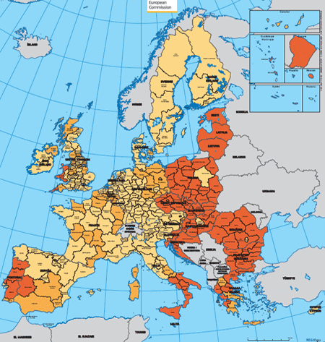
Transnational Exchange ERDF co-financing
Co-financing from ERDF of beneficiary cities and other eligible beneficiaries for the actions implemented
Less developed and transition regions shall receive 85% ERDF contribution
More developed shall receive 70% ERDF contribution

Slide 9
Thematic Concentration
Thematic concentration with a flexible approach
to find answers to the various needs of cities
To help achieve the EU2020 goals, concentration of 70% of transnational exchange budget to 5 Thematic Objectives:
strengthening research, technological development and innovation
supporting the shift towards a low-carbon economy in all sectors
protecting the environment and promoting resource efficiency
promoting social inclusion and combating poverty
promoting employment and supporting labour mobility
The remaining 30% will be available for all other themes based on a bottom up approach

Slide 10
Capacity-building
To build capacities on integrated and sustainable urban development
For urban practitionners, city managers and staff, elected representatives, other stakeholders involved in URBACT networks
By means of national and transnational training and capacity building actions:
National capacity-building seminars
URBACT universities
Ad hoc capacity building actions for elected representatives, managing authorities, etc.

Slide 11
PROVISIONAL CALENDAR 1st CALL
Febr 2015: 1st call for Action-planning
Febr-June 2015: applicants preparing bids
June 2015: submission of proposals
July-Aug 2015: eligibility check & assessment
Early Sept 2015: MC approval for networks to enter phase I
Mid Sept 2015- Mid March 2016: Phase I
Mid March 2016: submission Final Applications
Mid March-April 2016: eligibility check & assessment
April 2016: MC approval for networks to enter phase II
April 2016-April 2018: Networks deliver phase II

Slide 12

contact@urbact.eu
www.urbact.eu

